Slide 1


DESIGN 1
Lesson 1: Welcome Back: Tables 101 on the F1 Website
Ms. Abboud • Grade 9 - Design 1 • Term 1, Week 8

Slide 2
Learning Objectives
WALT - We Are Learning To
WILF - What I'm Looking For
Explain how tables organize data in rows and columns.
Add an F1 Quick Facts table to About Us.
The table renders with visible rows and columns.
The header row uses <th>, data rows use <td>.

Slide 3
Academic Vocabulary
Table
Table Row
The <table> tag, used to organize data into rows and columns, not for page layout.
The <tr> tag: one horizontal row of a table.
Table Data / Cell
Table Header
The <td> tag: one individual cell of data inside a table row.
The <th> tag: a cell for column or row titles, bold and centered by default.

Slide 4
Frayer Model: Table
DEFINITION
CHARACTERISTICS
The <table> tag, used to organize data into rows and columns, not for page layout.
The <table> tag; organizes data in rows/columns; not for layout.
TABLE
EXAMPLES
NON-EXAMPLES
The F1 Quick Facts table: Fact | Detail.
Using a table just to position text on a page.

Slide 5
National Identity Integration
UAE Statistical Information: the UAE publishes official data in clear tables so people can compare facts quickly. This week your F1 website presents real data, including facts about the Abu Dhabi Grand Prix.

Slide 6
STARTER
Welcome Back!
Round-robin: name one tag on your F1 website and what it does.
No repeats allowed.
Hook • Engage & Ask
5 - 10 minutes

Slide 7
LESSON CORE
I Do: How a Table Is Built
<table> wraps everything. <tr> is a row. <th> is a header cell; <td> is a data cell.
Tables are for data in rows and columns, not for positioning things.
Gradual Release of Responsibility
30 - 40 minutes
Example: the first two rows of F1 Quick Facts
<table>
<tr>
<th>Fact</th>
<th>Detail</th>
</tr>
<tr>
<td>Drivers per team</td>
<td>2</td>
</tr>
</table>
1 / 3

Slide 8
LESSON CORE
We Do: Frayer Model and Header Row
Complete the Frayer Model for Table together.
Build the header row together: Fact and Detail in <th> cells.
Gradual Release of Responsibility
30 - 40 minutes
2 / 3

Slide 9
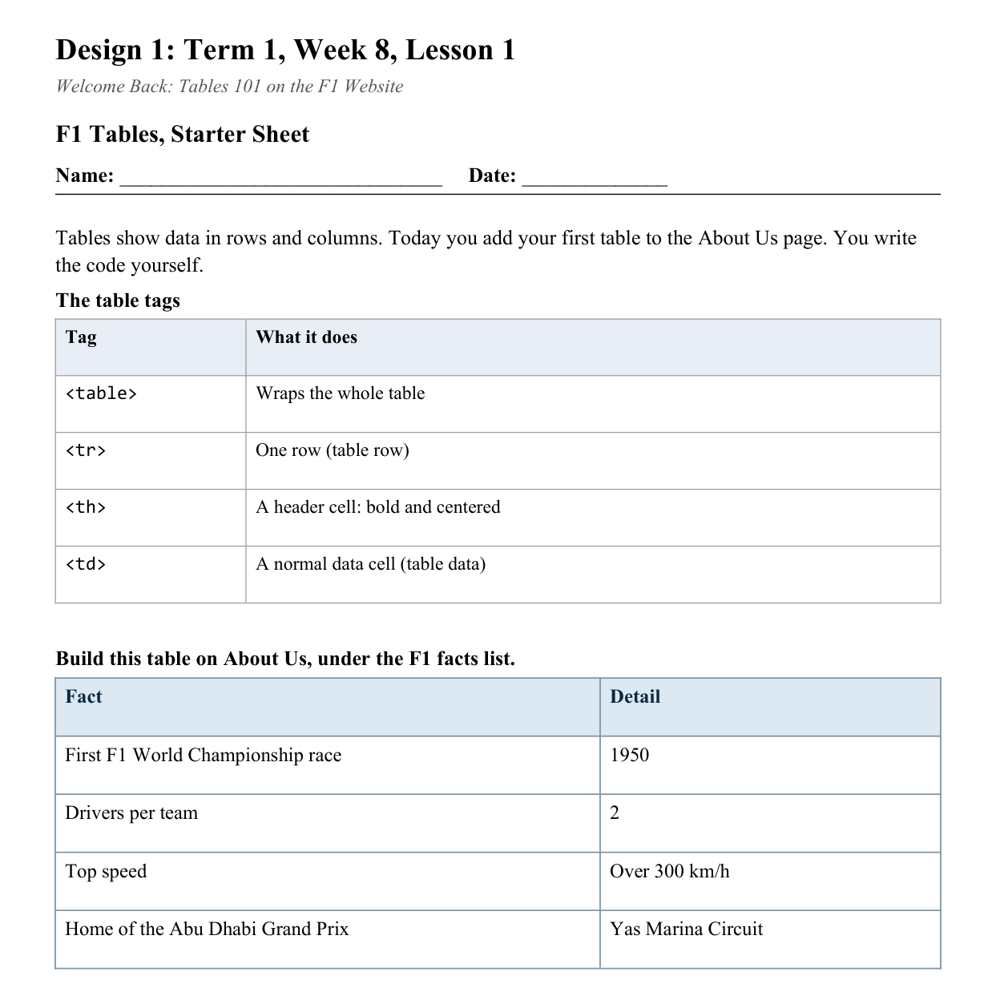
LESSON CORE
You Do: F1 Quick Facts
Add the F1 Quick Facts table to About Us, under the facts list.
You write the code from the Starter Sheet.
Activity: F1 Tables, Starter Sheet
Gradual Release of Responsibility
30 - 40 minutes
3 / 3

Slide 10
CLOSURE
Exit Ticket
What's the difference between <th> and <td>?
Transition & Extend
5 - 10 minutes

